Slide 1
Some (Fairly) Unique Features of Carolina Water Law
By Richard Whisnant, UNC Chapel Hill
NC Environmental Management Commission
Water Allocation Committee
Jan. 9, 2019

Slide 2
Overview
Thinking about water at multiple scales
What’s regulated and what’s not when it comes to water in NC…and why?
What’s planned about water in NC, and how?
Strengths/weaknesses/opportunities/threats for Carolina water resources

Slide 3
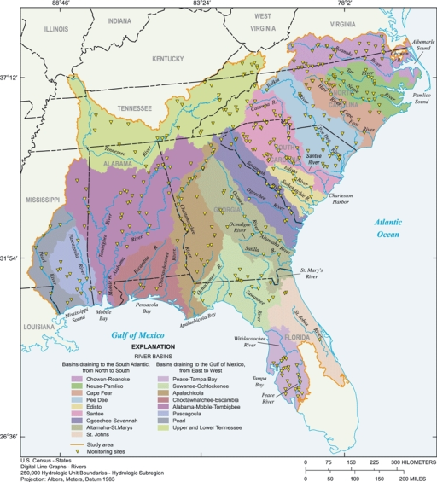
On scale: the region, the states, the basins

Slide 4
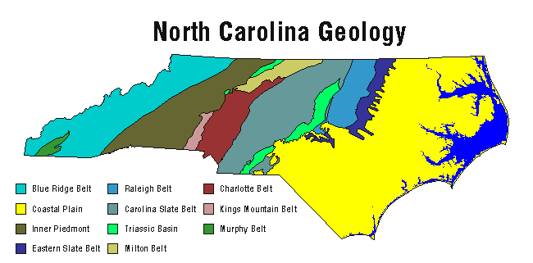
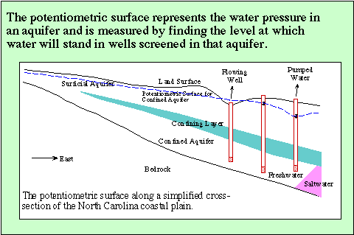
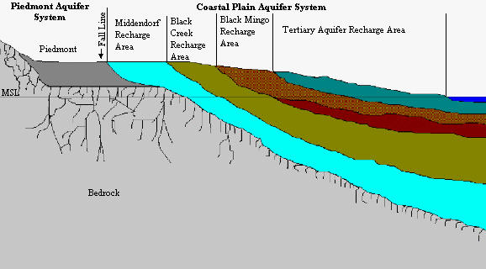
Aquifers in the Carolinas

Slide 5
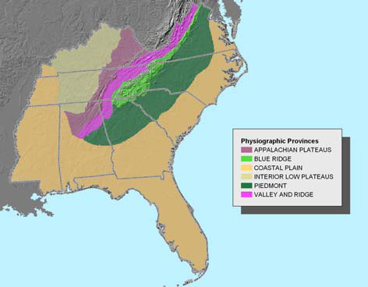
Our (region’s) big water challenge: growth in areas lacking water storage
. . . a region with good average precipitation, but small streams and low yields from groundwater. Shallow reservoirs have severe nutrient overenrichment problems.
A huge percentage of the South’s population, growth and economic prospects lies in the piedmont . . .
Ralottanham
Result: low resilience; high susceptibility to drought; almost certain escalation in conflict over water unless growth stops.

Slide 6
What’s regulated and what’s not in NC water…and why
Extraction
Not!
Aqua currit et debet currerer,
ut currerer solebat!
Which really means we are “regulated” by ancient riparian rights principles (and how well the courts apply them)

Slide 7
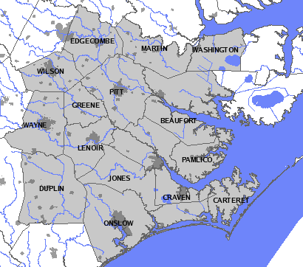
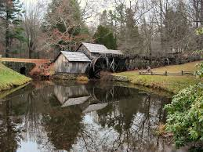
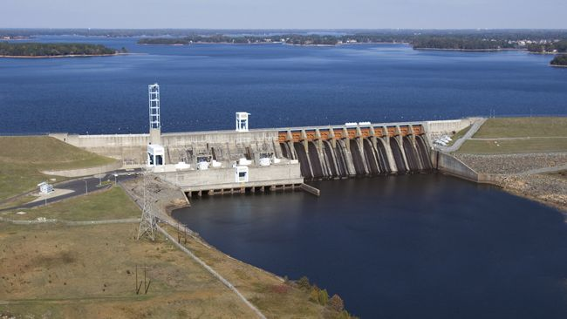
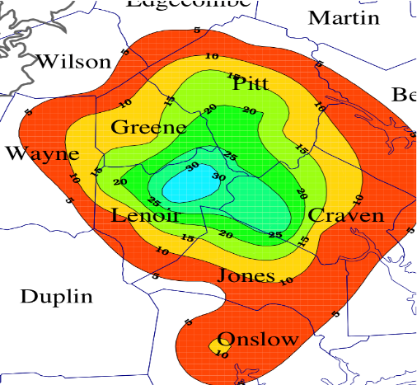
“Pure” riparian rights failed long ago
Judicial doctrine of “reasonable use”
Capacity use area statute and rules
The “regulations” that replaced them have worked fairly well

Slide 8
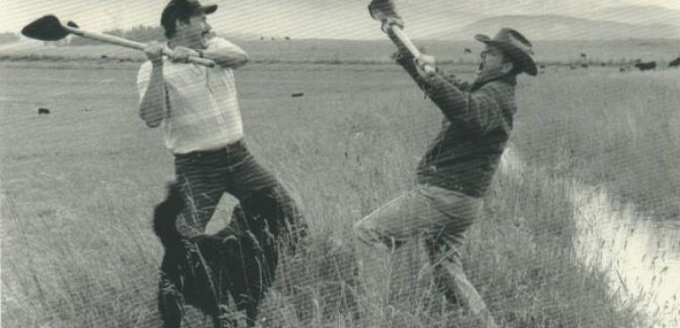
(At least) when it comes to water, there is no such thing as “free market”
See 1795 N.C. Sess. Laws ch. 7 (reprinted in N.C. Laws Compilation of 1804 at 76). The law is still on the books today, G.S. 156-2 et seq.

Slide 9
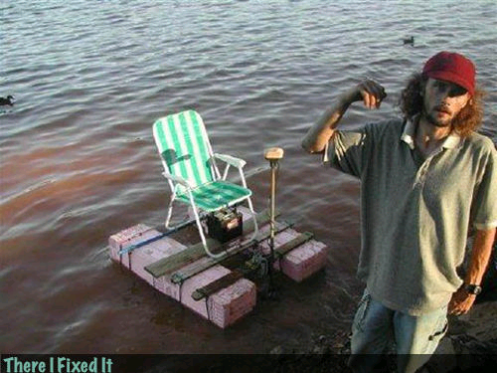
Sure, we have a regulated riparian system
And this guy has a bass boat….

Slide 10
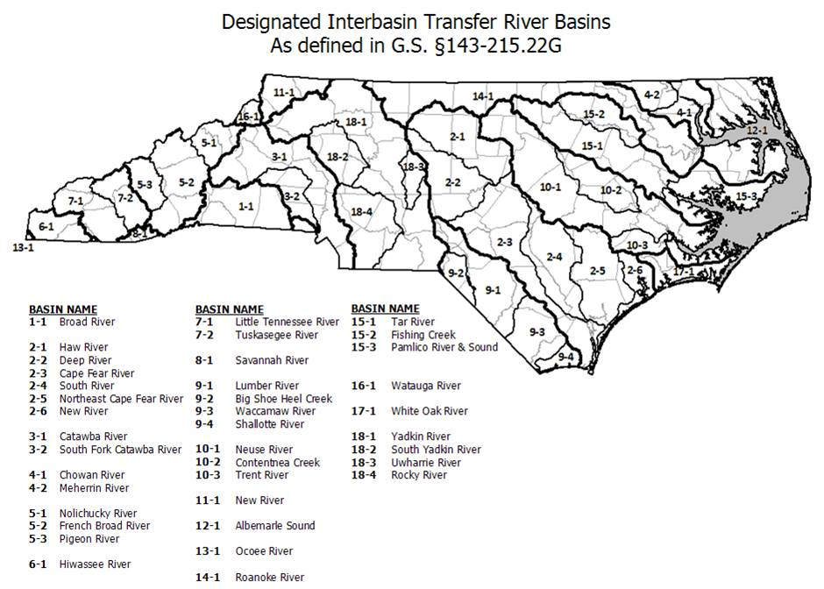
What’s regulated and what’s not in NC water…and why
Interbasin transfer
Definitely!
NC is one of the (if not THE) most regulated states in the U.S. for interbasin transfers

Slide 11
Geography and historical development imply many IBTs in NC

Slide 12
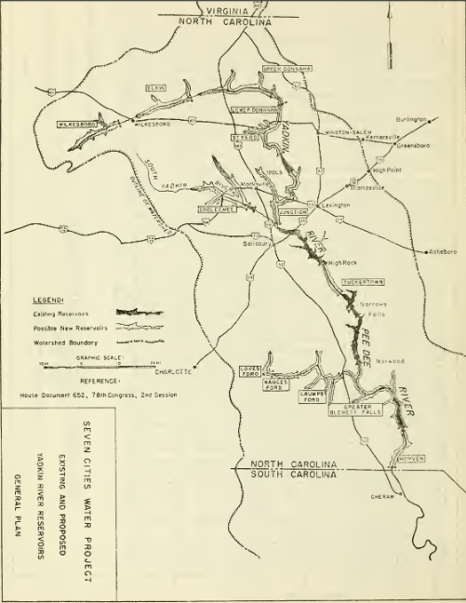
The Seven Cities project: roots of our IBT approach, death of a central planning approach?

Slide 13
What’s “planned” about NC water…and why
“State water plan” never amounted to much
Local water supply/watershed plans probably useful, rarely scaled right for water problems
Good plans have usually been driven from local levels to meet fed/regional/State needs
Some hydrologic models in place

Slide 14
NC Hydrologic Model status
Calendar Year | Status of River Basin Hydrologic Models
Completed models
2011 | Broad and Tar models completed
2012 | Broad receives EMC approval; Cape Fear and Neuse combined model begun
2013 | Catawba, Roanoke, Cape Fear and Neuse combined models completed
2014 | Tar-Pamlico model completed
Schedule for remaining basins
2018 | French Broad, New, and Watauga (working contract)
2019 | Lumber and Yadkin Pee Dee (as or when funds are available)
2020 | Hiwassee and Little Tennessee (as or when funds are available)
 | Albemarle Sound, Chowan, Onslow Bay, and Savannah

Slide 15
Strengths of NC water regulation
Goal of integrating water resources/water quality/surface water/groundwater is good
We have done it on the cheap – which works ok when it rains the “right way” and there are no major water quality problems
Mostly pragmatic, not too dogmatic
Lots of models for regional cooperation

Slide 16
Weaknesses of NC water regulation
System evolved without concern for scarcity
Questionable priorities in shortages: the farm vs. the city issue
Uncontrolled extraction
Still widespread reliance on run-of-river systems

Slide 17
Weaknesses in NC water policy, con.
“I had my lawyers research the question, and they told us that we could suck the state of Virginia out through that hole in the ground and there was nothing anyone could do about it.”
John. E. Ray III, Exec. VP, Union Camp (Savannah, Ga, July 16, 1970) (quoted in Fallows, The Water Lords (1971))

Slide 18
Weaknesses of NC water regulation, con.
Modeling still somewhat crude and incomplete
Regional and interstate water cooperation still has a long way to grow

Slide 19
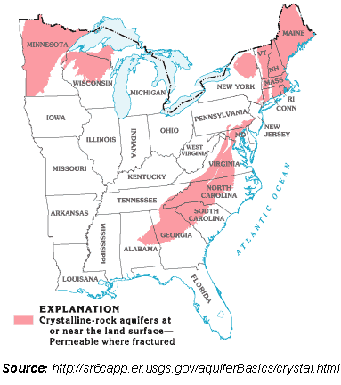
Eastern US regions and water
Great Lakes Compact
SuSusquehanna, Delaware Compancst
SuPotomac Commission
Institutional context: SEUSA is behind in regional water management
TVA
Water management districts

Slide 20
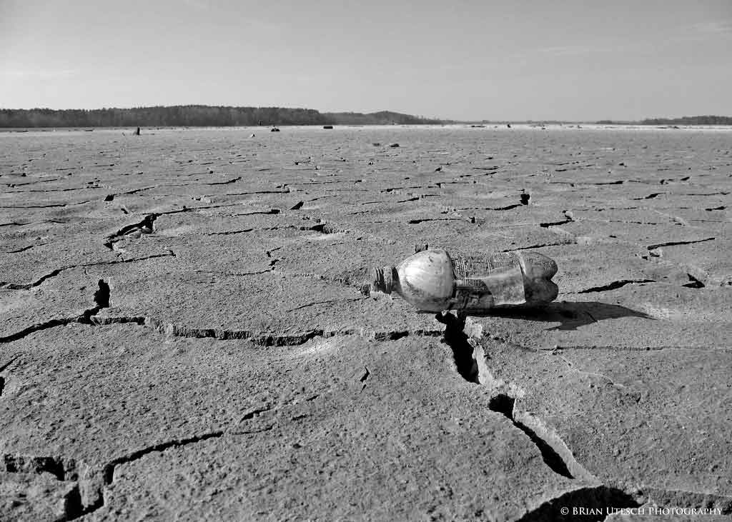
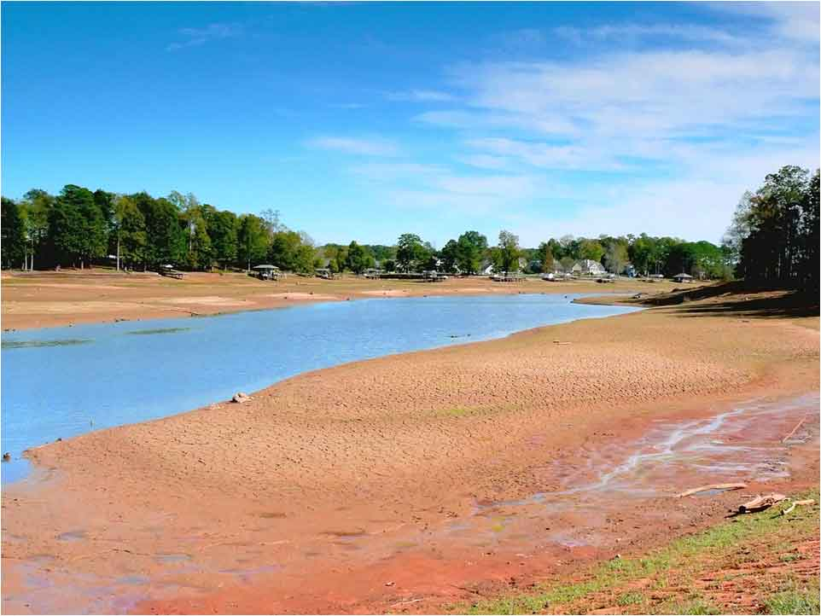
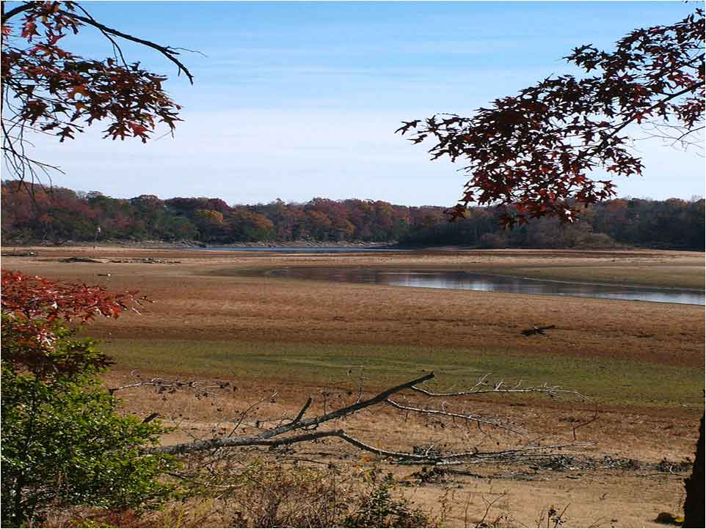
The resilience problem:
In 2007 every place in NC got at least 35” of rain.
How our water systems fared
Falls Lake
December 2007
Rocky Mount’s water reservoir Nov 2007
September 2007
Lake Michie, Durham County
October 2007
Question: how is it that we get more precipitation in 2007 than most of the USA gets in an average year, yet we are plunged into extreme drought?

Slide 21
Opportunities for NC water resources
The rare nonpartisan environmental problem
Business interests and basic human needs might transcend other policy divisions
Water prices have risen, but still very low
Rising recognition of water as a key environmental and economic asset

Slide 22
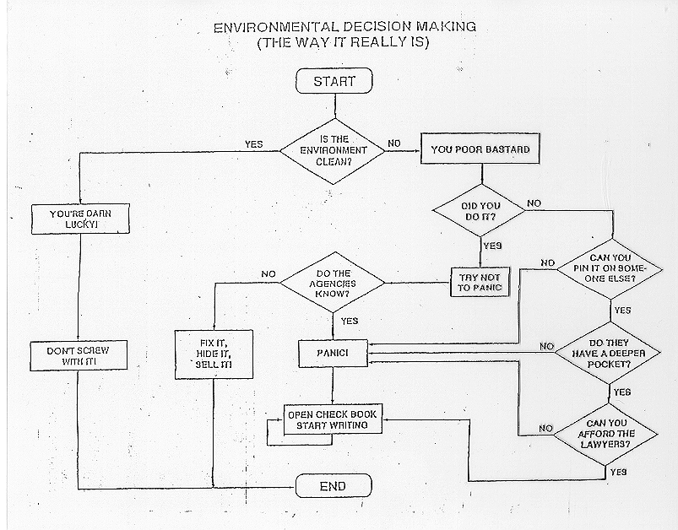
A Dept. of Commerce View of Environmental Assets, c. 1997

Slide 23
Threats to better NC water resources
Complacency among major water users...”we got ours, keep your hands off”
Poor citizen and cultural understanding of threats to water
Slow variables…nutrient overenrichment, emerging contaminants, deferred maintenance…

Slide 24
What is the right scale to tackle these long-term water concerns?
NC’s traditional approach
Leave it up to individual water systems to solve
Small, weak state agency monitoring with required reports from local systems and a powerful but politically difficult ability to single out areas for more regulation (“Capacity use areas”)
Enjoy but don’t try hard to steer federal efforts
Water allocation study (2008, 2010) recs
Continue primacy of local systems
But put more resources and power behind river-basin scaled planning organizations, at least where scarcity is expected in the next 50-75 years

Slide 25
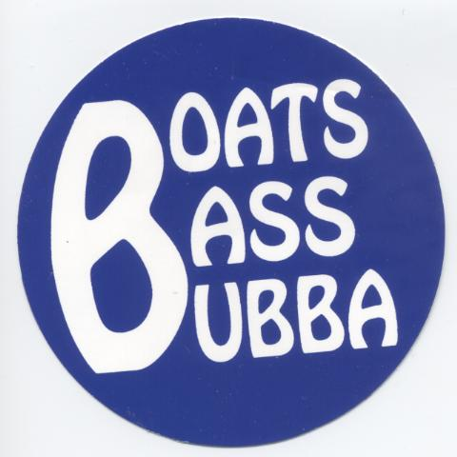
Conclusion
The brownfields model:
Get the right folks around the table and give them some real resources to work with…but who are those folks?

